Slide 1
Title of the project
Under guidance of
Mr/Dr. Faculty,
Designation,
BIT,
Sathy.
Student 1 (Roll number & Name)
Student 2 (Roll number & Name)
Student 3 (Roll number & Name)
Student 4 (Roll number & Name)

Slide 2
Abstract
Smart agriculture is an emerging concept, because IOT sensors are capable of providing information about agriculture fields and then act upon based on the user input. The feature of this paper includes development of a system which can monitor temperature, level of water, moisture and even the movement if any happens in the field which may destroy the crops in agricultural field through sensors using Arduino UNO board. Smart agriculture is an emerging concept, because IOT sensors are capable of providing information about agriculture fields and then act upon based on the user input. The project aims at making use of evolving technology i.e. IOT and smart agriculture using automation. Once hardware has been developed depending on the change in requirements and technology the software needs the updating. The updated hardware is called new version of the software. This new version is required to be tested in order to ensure changes that are made in the old version work correctly and it will not bring bugs in other part of the software. This is necessary because updating in one part of the hardware may bring some undesirable effects in other part of the hardware.

Slide 3
Problem Statement Addressed
To provide efficient decision support system using wireless sensor network which handle different activities of farm and gives useful information related to farm. Information related to Soil moisture, Temperature and Humidity content. Due to the weather condition, water level increasing Farmers get lot of distractions which is not good for Agriculture. Water level is managed by farmers in both Automatic/Manual using that mobile application. It will make more comfortable to farmers. Performing agriculture is very much time consuming

Slide 4
Existing Solution to the Problem Addressed
hardware and cost. This overcomes the manual operations required to monitor and maintain the agricultural farms in both automatic and manual modes. It should be able to measure the increase or decrease It should utilize minimum resources in terms of in level of water as well as moisture in the soil.

Slide 5
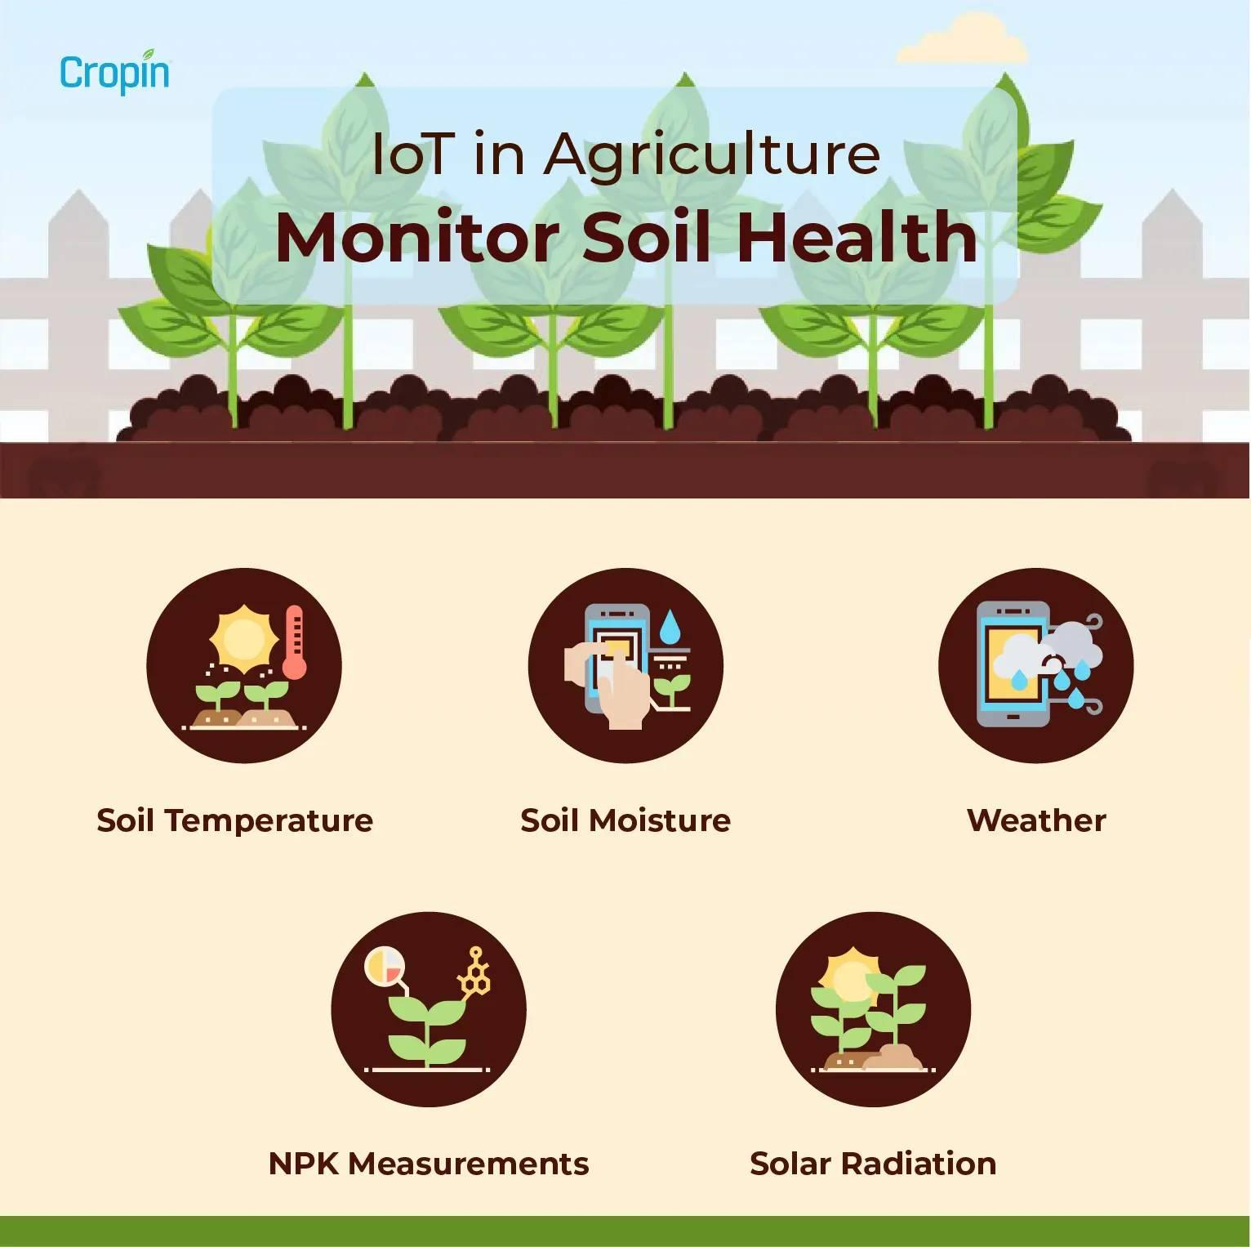
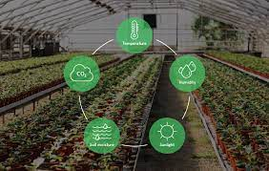
Proposed Solution to the Problem Addressed

Slide 6
Project Work Plan
(How the project will be implemented to achieve the Outcome,
Including Inputs, Activities, Timeframe, Role Assignment, and Outputs;
Gantt Chart included)

Slide 7
Block Diagram and/or Circuit Diagram
(Detailed Block Diagram explaining the input, processing units & output need to be included)

Slide 8
Flow Chart
(Which explains the Project work flow for various conditions)

Slide 9
Effective utilization of the Modern Tool & Cloud
Implementation, Testing & validation and usage of website or App or anything
Name of the cloud platform & reason for choosing the same need to be explained

Slide 10
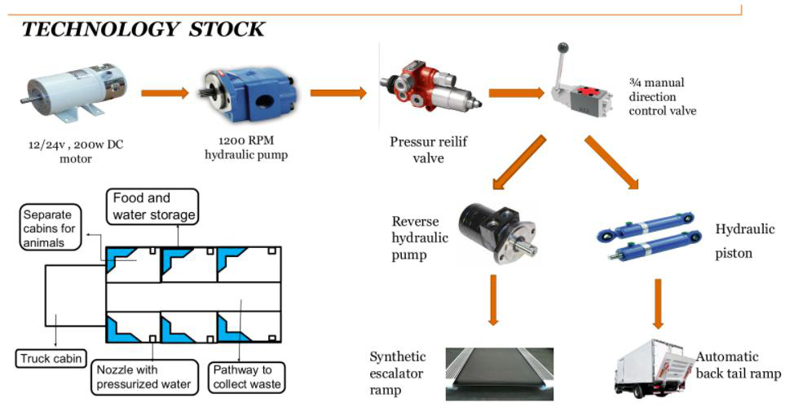
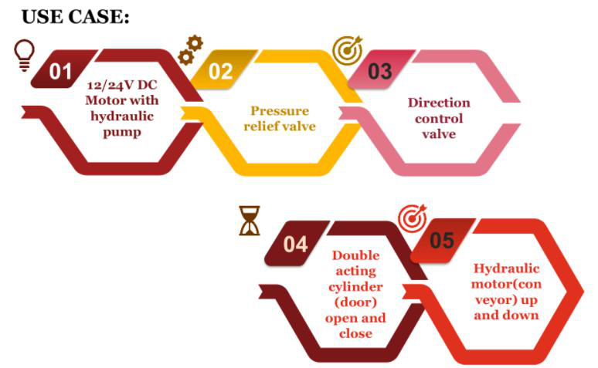
Technology stack & use case

Slide 11
Prototype & Sample Output
May include the image of the designed prototyping model / relevant pictures / Sample output image

Slide 12
Analysis of Results & Discussions
(Included clear analysis, along with advantages and disadvantages,
Conclusions)

Slide 13
Cost Benefit Analysis (List of Components / Service Used)
(Budget)
S.No | Component Name | Specification (IC number or Range or Value) | Unit Cost | Total Cost

Slide 14
Working video Link (If available)
(demo working Video shall be inserted)

Slide 15
References
Ariponnammal, S. and Natarajan, S. (1994) “Transport Phonomena of SmSel – Xasx”, Pramana – Journal of Physics Vol.42, No.1, pp.421-425.
Barnard, R.W. and Kellogg, C. (1980), “Applications of Convolution Operators to Problems in Univalent Function Theory”, Michigan Mach, J., Vol.27, pp.81-94.
Shin, K.G. and Mckay, N.D. (1984), “Open Loop Minimum Time Control of Mechanical Manipulations and its Applications‟, Proc. Amer. Contr. Conf., San Diego, CA, pp. 1231-1236.
(sample references, the same format should be followed throughout)

